Slide 1
Secure Online Voting Systems using Blockchain
The Future Of The Electoral Process

Slide 2
ABSTRACT
An important part of a democratically fair society are elections.
The conventional democratic framework becomes hard for the individuals who can’t visit the polling stall for casting their votes.
Security is a major worry for Internet voting system.
The proposed framework guarantees security prerequisites for example, validation, precision, secrecy, receipt-freeness, unwavering quality, obviousness and reasonableness in the political race.

Slide 3
What Is Online Voting ?
🞉 Online Voting is a form of voting in which individuals are able to cast their votes via the internet, through the use of a web interface.

Slide 4
Types Of Online Voting
Online Voting can be conducted through a number of methods:
Kiosk Internet Voting
Poll Site Voting
Remote Internet Voting

Slide 5
Benefits Of Online Voting
🞉 Expediency: Online voting would make it convenient for people to vote at any remote location.
🞉 Young Voter Appeal: Online Voting would attract young voters.
🞉 Expense Reduction : An online voting system could reduce expenses involved in setting up and staffing poll sites.

Slide 6
Security Issues
Authentication: Voters must be authenticated to ensure that the individuals voting are really who they say they are when they are voting remotely over the internet.
Vote Transport and Storage: Votes must be securely transmitted over the internet, processed efficiently and stored in a secure database.

Slide 7
Security Issues
Multiple Votes Prevention: The system must be designed so that each voter can vote only once.
Attacks on Online Voting Systems: Servers used for processing the electronic ballots submitted must be secure and unsusceptible to viruses.

Slide 8
Network Security Attacks
Denial of Service Attack (DOS): A DOS attack is an attack on a computer or network system that causes the systems users to be deprived of services which the system provides.
Man-In-The-Middle Attack (MITM): MITH attack is an attack in which data being transmitted between two parties on a network is intercepted, read and modified by the system attacker without the communicating parties knowing that their data has been compromised.

Slide 9
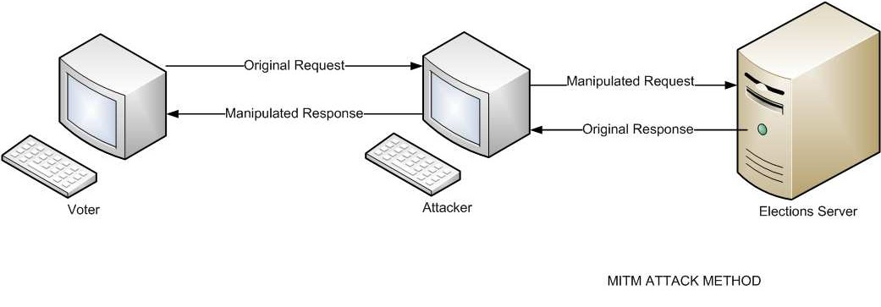
Network Security Attacks

Slide 10
Encrypted Communication
Online Voting systems which deal with confidential and sensitive data have to provide a means in which data communication between the client
and the server is encrypted.
In order protect data being transmitted by this type of Online system the following security measures should be taken:

Slide 11
EXISTING SYSTEM
This work modified coercion resistance problem, RSA Encryption, Online Voting process, Developing a Secure Solution for online Election process information and To solve coercion resistance problem to solve using RSA cryptographic algorithms.

Slide 12
DISADVANTAGES
Time Consuming
Less Security

Slide 13
PROPOSED SYSTEM
1) It is a symmetric key cryptographic scheme, which encrypts message using public key and retrieve message back from ciphertext using corresponding private key.
2) Blockchain has probabilistic nature. Every time the ciphertext is encrypted using Blockchain system a new cipher text is generated, due to which it is difficult to uniquely identify whether both the ciphertext are generated for same message or not.
3) It supports additive property of homomorphic cryptosystem[3].

Slide 14
PROPOSED SYSTEM
🞉 This form of Blockchain is known as the secret Hash cryptography.
🞉 It makes use of the same private key to Hash and Dehash data being transmitted between two or more users.
🞉 Hash Cryptography makes use of a block cipher encryption method.

Slide 15
SHA 512 HASH ALGORITHM
🞉 The Homomorphic Algorithm is a block cipher that works on fixed size blocks of data.
🞉 A complete message must be split into blocks of plain text of 64bits.
🞉 A 56 bit secret key is to used to encrypt each block of plain text to 64bit cipher text which is then transmitted through a network.
🞉 The receiver uses the same secret key to decrypt each 64bit data block, arranging the blocks into the original message.

Slide 16
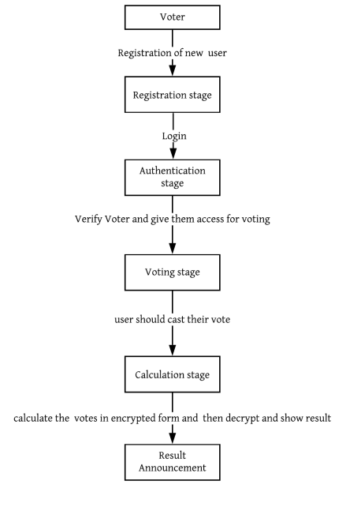
Block Diagram

Slide 17
HARDWARE /SOFTWARE REQUIREMENTS
HARDWARE REQUIREMENTS
Processor - I3 Above
Speed - 2.4 Ghz
RAM - 4 Gb (min)
Hard Disk - 500 Gb
Key Board - Standard Windows Keyboard
Mouse - Two or Three Button Mouse
Monitor - SVGA
SOFTWARE REQUIREMENTS
Operating System : Windows
Front End : Anaconda Navigator
Database : SQL
Language : Python, HTML

Slide 18
Conclusion
Blockchain Based Online Voting can be the future of the government electoral process if all security criteria previously mentioned are addressed and efficient internet security techniques are utilised in protecting information relayed over the internet.

Slide 19
Thank You

